Slide 1



LISA - LIP AND SIGN ASSISTANT
THEME : Assistive Technology and Accessible
Communication in Healthcare
TEAM MEMBERS :
Rohith G - 9123106062
Praveen R - 9123106054
Sandhya R - 9123106066
MENTOR :
Dr. Maheshwari
Assistant Professor
Dept of Electronics and Communication

Slide 2
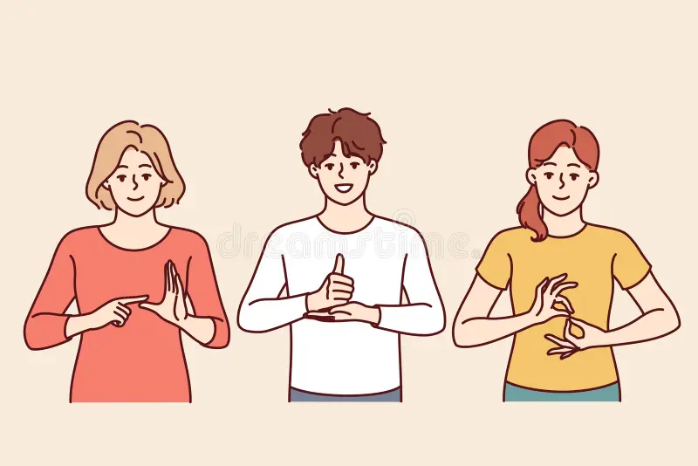
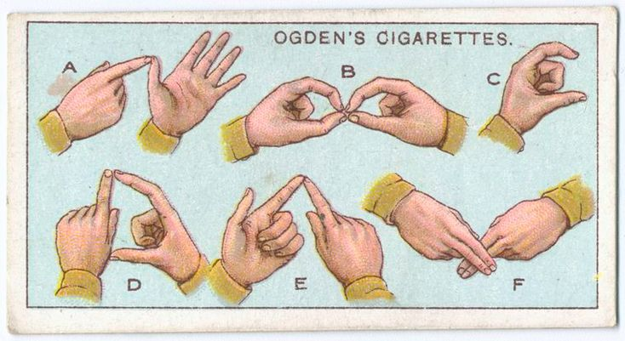
ABSTRACT
The Lip and Sign Assistant (LISA) is an assistive system that bridges communication gaps for people with hearing and speech impairments. Using digital signal processing, image, and motion analysis, LISA interprets lip movements and sign language gestures in real time, converting them into text or speech. It integrates pattern recognition and assistive technology to deliver a cost-effective, user-friendly communication tool.

Slide 3
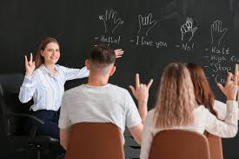

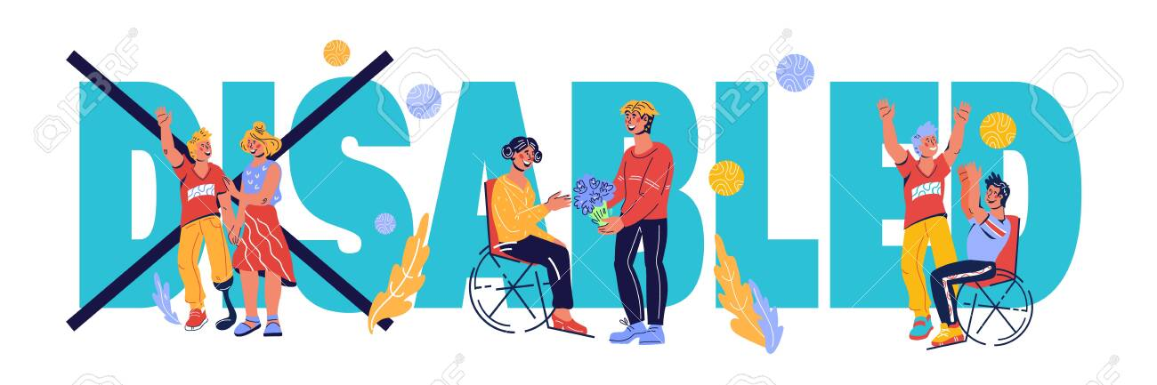
INTRODUCTION
LISA – Sign Conversation is an AI-powered system that translates sign language into speech or text in real time. It accurately recognizes hand gestures, enabling natural interaction between the deaf-mute community and the hearing world. Portable and user-friendly, LISA fosters inclusivity across mobile and web platforms.

Slide 4
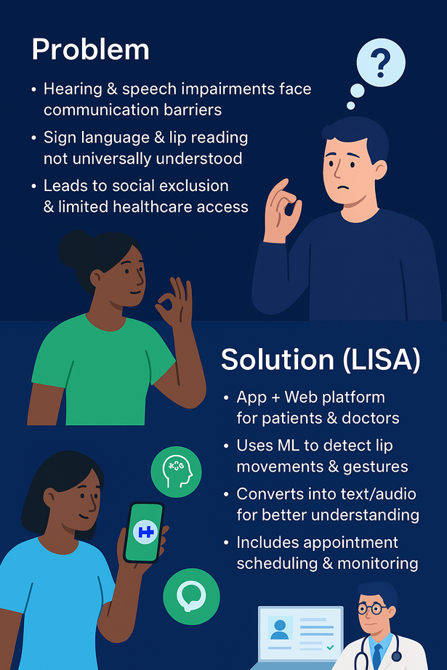
PROBLEM STATEMENT
“ People with hearing and speech impairments face significant challenges in communicating with others, as conventional methods like sign language and lip reading are not universally understood “
SOLUTION STATEMENT
App and Website for patients & doctors.
Uses ML to detect lip movements & gestures.
Converts into text for better understanding.
Doctors access records with secure User ID.
includes appointments scheduling and monitoring.

Slide 5
LITERATURE SURVEY
Team Alignment Meeting
Date and Time: June 1, 2025, 10:00 AM
Attendees: Alice, Wyatt, Frank, Trish, and Ben
S.NO
Paper Tittle/ Year
Author Name
Discussion
Lip Image Segmentation Based on a Fuzzy Convolutional Neural Network
Cheng Guan, Shilin Wang, Alan Wee-Chung Liew
Proposes a fuzzy convolutional neural network (LSFCNN) integrating fuzzy logic with CNN for robust lip segmentation.
Achieves state-of-the-art performance in handling variations like lighting and open-mouth complexity.
1
Year: 2020
“ LipNet: End-to-End Sentence-level Lip Reading ” by Yannis Assael, Brendan Shillingford, Shimon Whiteson, and Nando de Freitas (IEEE, 2016) introduced the first deep learning model capable of performing sentence-level lip reading.
Yannis Assael, Brendan Shillingford, Shimon Whiteson,
First model to perform sentence-level lip reading using CNN + RNN.
Achieved higher accuracy than humans on benchmark datasets.
Directly supports LISA’s goal of recognizing lip sequences into words.
2

Slide 6
S.NO
Paper Title/ Year
Author Name
Discussion
Team Alignment Meeting
Lip-Reading Driven Deep Learning Approach for Speech Enhancement
Ahsan Adeel, Mandar Gogate, Amir Hussain, William M. Whitmer
Introduces a stacked LSTM-based lip-reading regression model combined with an enhanced visually-derived Wiener filter (EVWF) for speech enhancement.
Improves speech intelligibility in noisy environments using audiovisual cues
3
Year: 2021
Acoustic-Based Lip Reading for Mobile Devices: Dataset, Benchmark and a Self Distillation-Based Approach
Yafeng Yin, Zheng Wang, Kang Xia, Lei Xie, Sanglu Lu
Presents LIPCMD, a large-scale acoustic-based lip reading dataset, and a self-distillation-based approach called LipReader.
Achieves 91.58% accuracy and demonstrates deployment feasibility on smartphones
4
Year: 2024
Collaborative meetings are the best! Click "Share," add your teammates, and start interacting.

Slide 7
S.NO
Paper Title/ Year
Author Name
Discussion
Team Alignment Meeting
Collaborative Viseme Subword and End-to-End Modeling for Word-Level Lip Reading
Hang Chen, Qing Wang, Jun Du, Gen-Shun Wan, Shi-Fu Xiong, Bao-Ci Yin, Jia Pan, Chin-Hui Lee
Proposes hybrid and collaborative frameworks (HVSEM, CVSEM) combining viseme subword modeling with end-to-end models.
Achieves new benchmarks on LRW and LRW-1000 datasets, improving accuracy and generalizability
5
Year: 2024
Deep Learning-Based Holistic Speaker Independent Visual Speech Recognition
Praneeth Nemani, Ghanta Sai Krishna, Nikhil Ramisetty, B Digvijay Sri Sai, Santosh Kumar
Proposes a 3D CNN-based speaker-independent VSR system (LIPAR) using spatio-temporal features.
Achieves 77.9% testing accuracy and develops a smartphone prototype for edge-device deployment
6
Year: 2023
Collaborative meetings are the best! Click "Share," add your teammates, and start interacting.

Slide 8
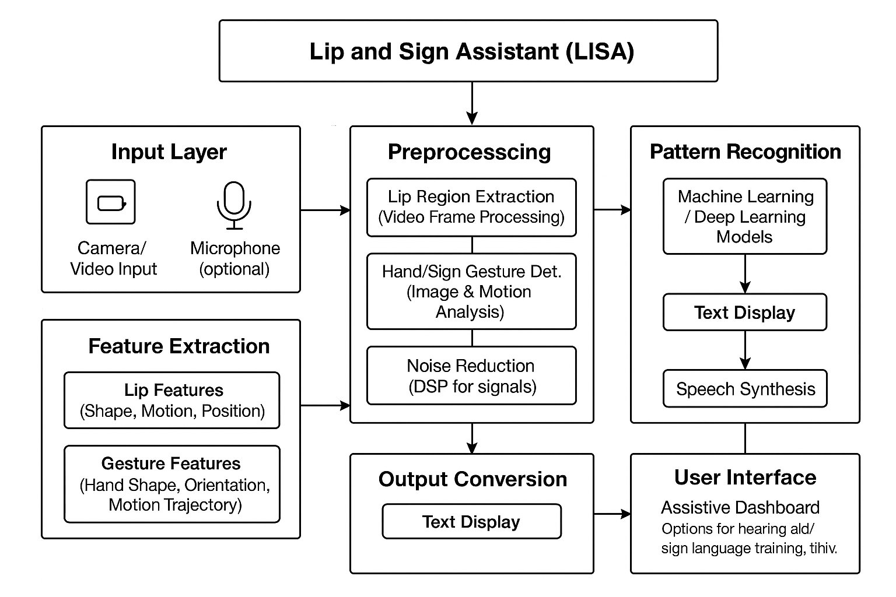
BLOCK DIAGRAM FOR PROPOSED SYSTEM

Slide 9
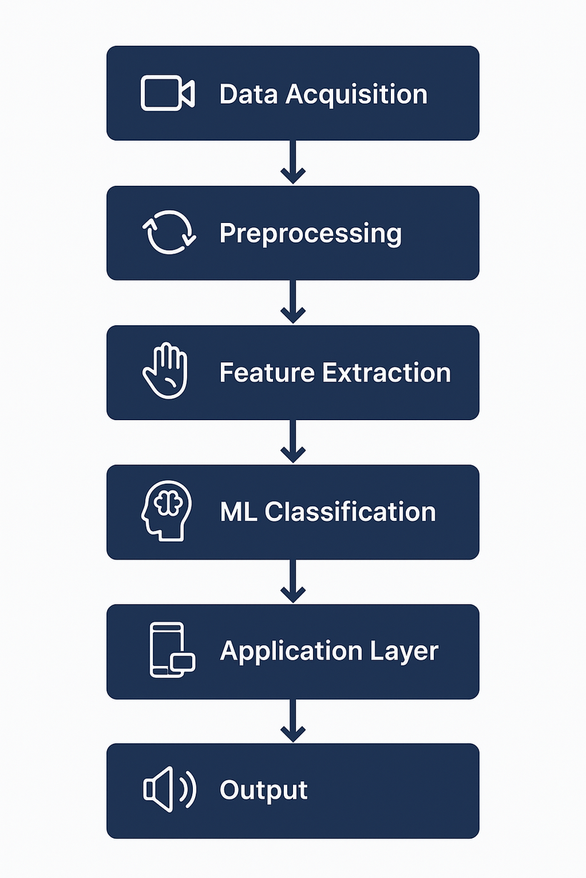
METHODOLOGY USED
1️⃣Data Acquisition – Capture lip & hand gesture videos.
2️⃣ Preprocessing – Frame conversion, segmentation, noise removal.
3️⃣ Feature Extraction – Detect contours, bounding boxes, gestures.
4️⃣ ML Classification – Train & classify using ML models (SVM/CNN).
5️⃣ Application Layer – Mobile App (text/audio) + Web Portal (records).
6️⃣ Output – Real-time text + doctor access via user ID.

Slide 10
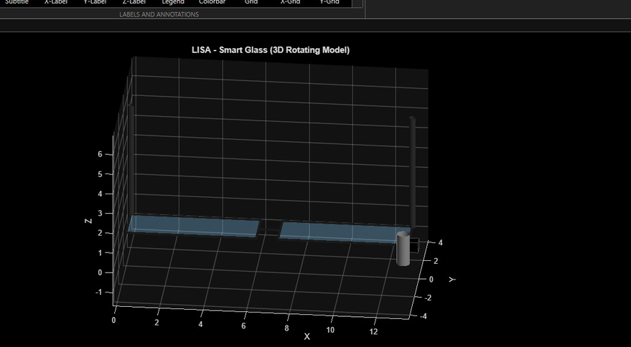
HARDWARE SETUP
MAIN COMPONENTS :
3D - MODEL
Smart Glasses Frame: Lightweight frame to hold components.
Webcam/Camera Module: Small wide-angle camera mounted on glasses for lip/sign capture.
The system utilizes a webcam-based hardware setup for video acquisition, offering a controlled environment for data capture.
RESULT

Slide 11

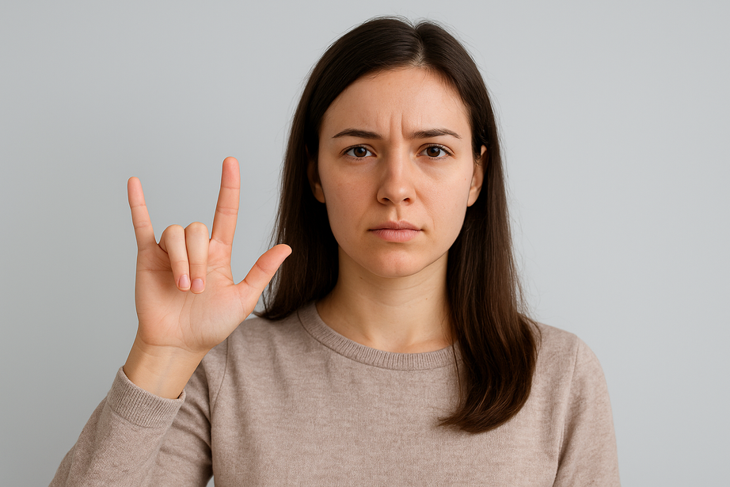
FUTURE WORK
Add real-time speech-to-text AI.
Support for regional languages.
Wearables (AR/Smart glasses) for live gesture detection
Cloud storage for scalable data access.
Chatbot assistants for basic guidance.
Predictive analytics for patient progress.
CONCLUSION
LISA bridges communication gaps for the hearing & speech impaired by combining ML, computer vision, and a web–mobile platform.
It ensures better healthcare access, secure doctor–patient interaction, and improved quality of life for specially-abled individuals.

Slide 12
REFERENCES
1). Guan, C., Wang, S., & Liew, A. W.-C. (2020). Lip Image Segmentation Based on a Fuzzy Convolutional Neural Network.This work integrates fuzzy logic with CNNs (LSFCNN) to achieve robust lip segmentation, handling lighting variations and complex mouth movements.
2). Assael, Y., Shillingford, B., Whiteson, S., & de Freitas, N. (2016). LipNet: End-to-End Sentence-Level Lip Reading.Introduces the first deep learning model capable of sentence-level lip reading using CNN+RNN, outperforming human accuracy on benchmark datasets.
3). Adeel, A., Gogate, M., Hussain, A., & Whitmer, W. M. (2021). Lip-Reading Driven Deep Learning Approach for Speech Enhancement. Presents a stacked LSTM-based regression model combined with a visually-derived Wiener filter to enhance speech intelligibility in noisy environments.

Slide 13
4). Yin, Y., Wang, Z., Xia, K., Xie, L., & Lu, S. (2024). Acoustic-Based Lip Reading for Mobile Devices: Dataset, Benchmark and a Self Distillation-Based Approach. Proposes the LIPCMD dataset and a self-distillation-based system (LipReader), achieving 91.58% accuracy and demonstrating smartphone deployment feasibility.
5). Chen, H., Wang, Q., Du, J., Wan, G.-S., Xiong, S.-F., Yin, B.-C., Pan, J., & Lee, C.-H. (2024). Collaborative Viseme Subword and End-to-End Modeling for Word-Level Lip Reading.
Combines viseme subword modeling with end-to-end frameworks (HVSEM, CVSEM), improving accuracy and generalization on LRW and LRW-1000 datasets.
6). Nemani, P., Krishna, G. S., Ramisetty, N., Sri Sai, B. D., & Kumar, S. (2023). Deep Learning-Based Holistic Speaker Independent Visual Speech Recognition.
Develops a 3D CNN-based spatio-temporal model (LIPAR) for speaker-independent VSR, achieving 77.9% accuracy with a prototype for edge-device deployment.

